Slide 1
A/B testing
A way to compare two versions of something to figure out which performs better

Slide 2
Application of A/B testing to Digital Marketing
Old web page
New web page
VS
Convert 13% of viewers to paying customers
Convert 15% of viewers to paying customers
15%-13%=2%???

Slide 3
A/B testing steps
Designing our experiment
Collecting and preparing the data
Visualizing the results
Testing the hypothesis
Drawing conclusions

Slide 4
A/B testing steps
Designing our experiment
Formulating a hypothesis
Choosing the variables
Choosing a sample size

Slide 5
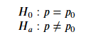
A/B testing steps
Designing our experiment
Formulating a hypothesis
Choosing the variables
Choosing a sample size
Two Tailed Test
confidence level of 95%
𝛼=0.05
15%-13%=2%???

Slide 6
A/B testing steps
Designing our experiment
Formulating a hypothesis
Choosing the variables
Choosing a sample size
Independent Variable(Group, assigned randomly)
Dependent Variable(converted)
A control group - They'll be shown the old design
A treatment (or experimental) group - They'll be shown the new design
0 - The user did not buy the product during this user session
1 - The user bought the product during this user session
Is there a relationship between Independent Variable and Dependent Variable?

Slide 7
A/B testing steps
Designing our experiment
Formulating a hypothesis
Choosing the variables
Choosing a sample size
It is important to note that since we won't test the whole user base (our population), the conversion rates that we'll get will inevitably be only estimates of the true rates.
the larger the sample size, the more precise our estimates ,the higher the chance to detect a difference in the two groups, if present.
So how many people should we have in each group?
Power analysis:
Power of the test ( 1−𝛽 ) - This represents the probability of finding a statistical difference between the groups in our test when a difference is actually present. This is usually set at 0.8 as a convention
Alpha value ( 𝛼 ) - The critical value we set earlier to 0.05
Effect size - How big of a difference we expect there to be between the conversion rates: 15%-13%=2%

Slide 8
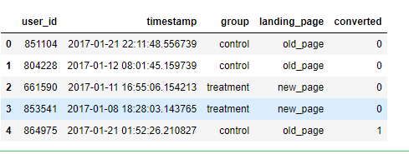
A/B testing steps
Designing our experiment
Collecting and preparing the data
Visualizing the results
Testing the hypothesis
Drawing conclusions
Make sure we have enough samples for each group

Slide 9
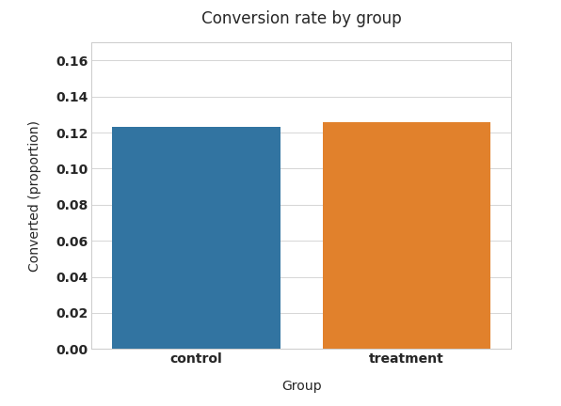
A/B testing steps
Designing our experiment
Collecting and preparing the data
Visualizing the results
Testing the hypothesis
Drawing conclusions

Slide 10
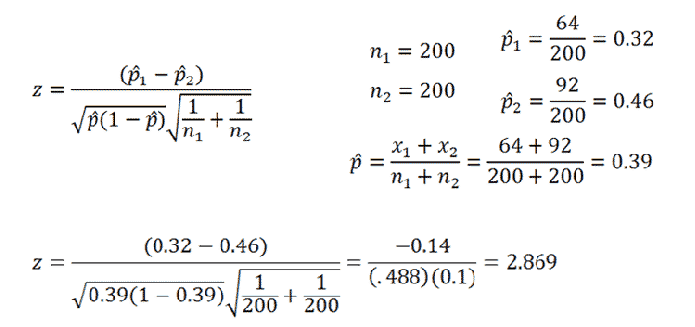
A/B testing steps
Designing our experiment
Collecting and preparing the data
Visualizing the results
Testing the hypothesis
Drawing conclusions
Test Result(using z-Test for Proportions, Two Samples)
z statistic: -0.34
p-value: 0.732
ci 95% for control group: [0.114, 0.133]
ci 95% for treatment group: [0.116, 0.135]

Slide 11
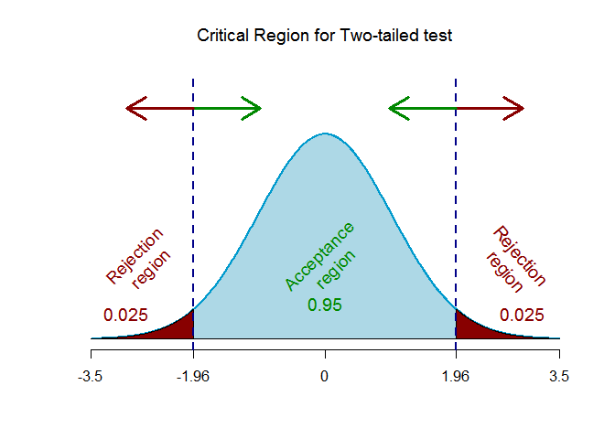
A/B testing steps
Designing our experiment
Collecting and preparing the data
Visualizing the results
Testing the hypothesis
Drawing conclusions
Test Result(using z-Test for Proportions, Two Samples)
z statistic: -0.34
p-value: 0.732
ci 95% for control group: [0.114, 0.133]
ci 95% for treatment group: [0.116, 0.135]

Slide 12
A/B testing steps
Designing our experiment
Collecting and preparing the data
Visualizing the results
Testing the hypothesis
Drawing conclusions
Test Result(using z-Test for Proportions, Two Samples)
A confidence interval (CI) is the mean of your estimate plus and minus the variation in that estimate. This is the range of values you expect your estimate to fall between if you redo your test, within a certain level of confidence. Confidence, in statistics, is another way to describe probability
z statistic: -0.34
p-value: 0.732
ci 95% for control group: [0.114, 0.133]
ci 95% for treatment group: [0.116, 0.135]

Slide 13
A/B testing steps
Designing our experiment
Collecting and preparing the data
Visualizing the results
Testing the hypothesis
Drawing conclusions
Since our 𝑝-value=0.732 is way above our 𝛼=0.05, we cannot reject the null hypothesis 𝐻0, which means that our new design did not perform significantly different (let alone better) than our old one
Additionally, if we look at the confidence interval for the treatment group ([0.116, 0.135], i.e. 11.6-13.5%) we notice that:It includes our baseline value of 13% conversion rate.It does not include our target value of 15% (the 2% uplift we were aiming for)
What this means is that it is more likely that the true conversion rate of the new design is similar to our baseline, rather than the 15% target we had hoped for. This is further proof that our new design is not likely to be an improvement on our old design, so the conclusion is that the new web page didn’t make a difference.

Slide 14
Business Data analysis/商业数据分析
银行内部审计和风险控制

Slide 15

Business Data analysis/商业数据分析
Business Problem statement
风险控制对银行的成功与失败至关重要！

Slide 16


Business Data analysis/商业数据分析
工作机会

Slide 17
Business Data analysis/商业数据分析
internal audit & RISK/风险和内部审计
内部审计internal audit ，是一种独立、客观的确认和咨询活动，它通过运用系统、规范的方法，审查和评价组织的业务活动、内部控制和风险管理risk management的适当性和有效性，以促进组织完善治理、增加价值和实现目标
内部审计internal audit在商业银行风险管理risk management中的作用
客观识别和评估风险
综合分析和计量风险
风险预警

Slide 18
Business Data analysis/商业数据分析
internal audit and DATA /
风险和内部审计与数据的关系
Internal audit in the age of data analytics数据时代下的内部审计
Fast-evolving technologies that generate-increasing amounts of data have created an opportunity机会 for internal audit departments to leverage data to evaluate risk and drive audit insight. As a result, data analytics is increasingly becoming an indispensable element不可分割的元素 of the internal audit toolset.
Data Analytics Transforms Internal Auditors Into Strategic Advisors策略顾问

Slide 19
Business Data analysis/商业数据分析
internal audit and DATA /
风险和内部审计与数据的关系
Audit Analytics & Financial Fraud Risk Analysis
审计分析和金融欺诈风险分析

Slide 20
Business Data analysis/商业数据分析
internal audit and DATA /
风险和内部审计与数据的关系
Sector_score | LOCATION_ID | PARA_A | PARA_B | numbers | Money_Value | District_Loss | History | Score | Risk
3.89 | 23 | 4.18 | 2.5 | 5 | 3.38 | 2 | 0 | 2.4 | 1
3.89 | 6 | 0 | 4.83 | 5 | 0.94 | 2 | 0 | 2 | 0
3.89 | 6 | 0.51 | 0.23 | 5 | 0 | 2 | 0 | 2 | 0
3.89 | 6 | 0 | 10.8 | 6 | 11.75 | 2 | 0 | 4.4 | 1
3.89 | 6 | 0 | 0.08 | 5 | 0 | 2 | 0 | 2 | 0
3.89 | 6 | 0 | 0.83 | 5 | 2.95 | 2 | 0 | 2 | 0
3.89 | 7 | 1.1 | 7.41 | 5 | 44.95 | 2 | 0 | 3.2 | 1
3.89 | 8 | 8.5 | 12.03 | 5.5 | 7.79 | 2 | 0 | 4.2 | 1
3.89 | 8 | 8.4 | 11.05 | 5.5 | 7.34 | 2 | 0 | 4.2 | 1

Slide 21
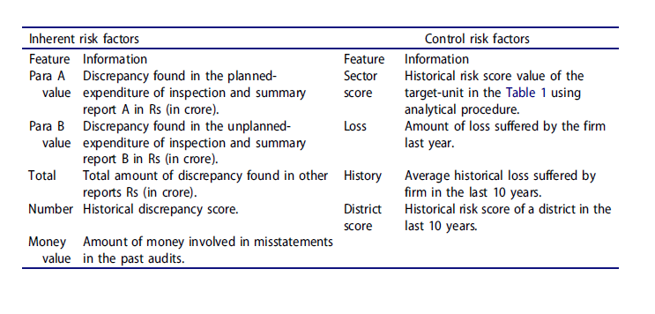
Business Data analysis/商业数据分析
Financial Fraud Risk Analysis

Slide 22
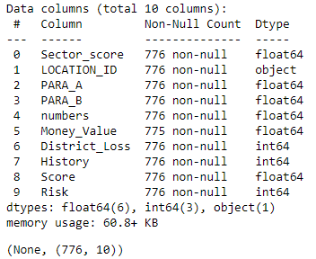
Business Data analysis/商业数据分析
Financial Fraud Risk Analysis
Exploratory Data Analysis(EDA)

Slide 23
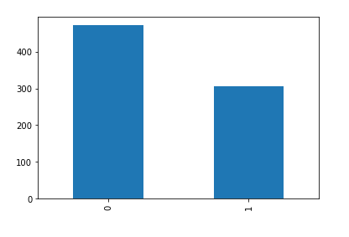
Business Data analysis/商业数据分析
Financial Fraud Risk Analysis
Exploratory Data Analysis(EDA)
Risk vs Non Risk ratio

Slide 24
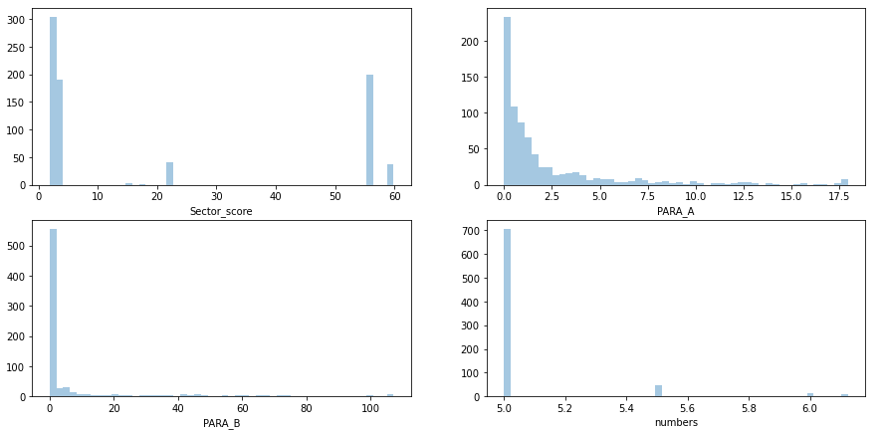
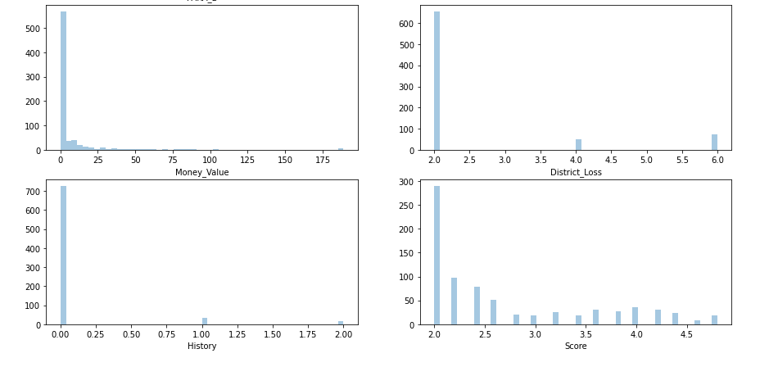
Financial Fraud Risk Analysis
Exploratory Data Analysis(EDA)
直方图(Histogram)，又称质量分布图
Histogram groups numeric data into bins, displaying the bins as segmented columns and summarize the distribution of a univariate data set.

Slide 25
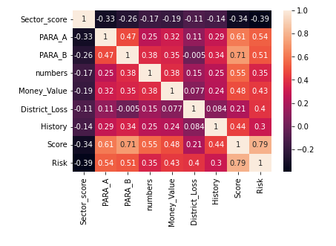
Financial Fraud Risk Analysis
Exploratory Data Analysis(EDA)
Correlation heatmap关联分析

Slide 26
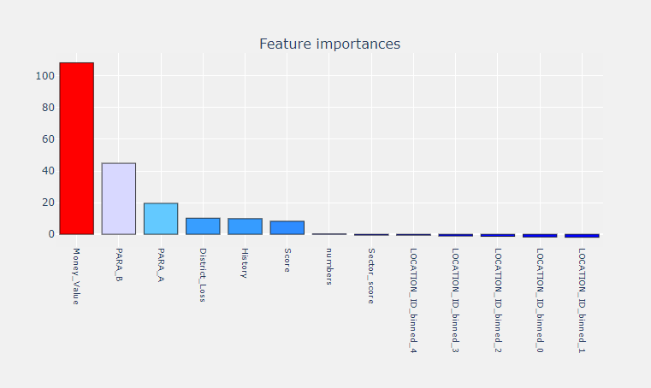
Financial Fraud Risk Analysis
Regression回归分析

Slide 27
Financial Fraud Risk Analysis
Financial Fraud Risk
Sector_score
numbers
Quantify/量化
One to Many/一对多关系
Ranking/排序
Explain/解释
Control/控制
Predict/预测
PARA_A
Money_Value
PARA_B
District_Loss
Regression Model 回归分析模型

Slide 28
Business Data analysis/商业数据分析
internal audit and DATA /
风险和内部审计与数据的关系
Audit Analytics & Bankruptcy Analysis
审计分析和破产分析

Slide 29
internal audit & RISK/风险和内部审计
银行破产主要风险
Internal Risks:
i.Industry risk (IR) 行业风险:
Government policies and International agreements,
Cyclicality,
Degree of competition,
The price and stability of market supply,
The size and growth of market demand,
The sensitivity to changes in macroeconomic factors,
Domestic and international competitive power,
Product Life Cycle.
ii.Management risk(MR)管理风险:
Ability and competence of management,
Stability of management,
The relationship between management/ owner,
Human resources management,
Growth process/business performance,
Short and long term business planning,
achievement and feasibility.
iii.Financial Flexibility(FF)金融灵活性:
Direct financing,
Indirect financing,
Other financing
Internal Risks:
iv.Credibility (CR)可信度（信用）:
Credit history,
reliability of information,
The relationship with financial institutes.
v.Competitiveness (CO)竞争性:
Market position,
The level of core capacities,
Differentiated strategy,
vi.Operating Risk (OP)操作风险:
The stability and diversity of procurement,
The stability of transaction,
The efficiency of production,
The prospects for demand for product and service,
Sales diversification,
Sales price and settlement condition,
Collection of A/R,
Effectiveness of sale network.

Slide 30
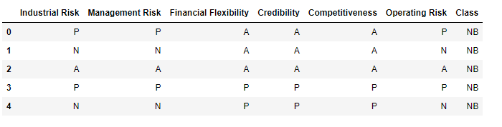
Business Data analysis/商业数据分析
internal audit and DATA /
风险和内部审计与数据的关系

Slide 31
Business Data analysis/商业数据分析
Bankruptcy Analysis
Attribute Information: (P=Positive,A-Average,N-negative,B-Bankruptcy,NB-Non-Bankruptcy)
1. Industrial Risk: {P,A,N}
2. Management Risk: {P,A,N}
3. Financial Flexibility: {P,A,N}
4. Credibility: {P,A,N}
5. Competitiveness: {P,A,N}
6. Operating Risk: {P,A,N}
7. Class: {B,NB}

Slide 32
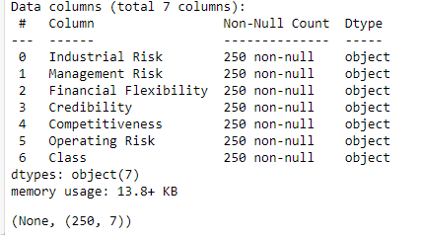
Business Data analysis/商业数据分析
Bankruptcy Analysis
Exploratory Data Analysis(EDA)

Slide 33
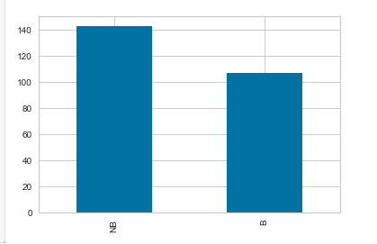
Business Data analysis/商业数据分析
Bankruptcy Analysis
Exploratory Data Analysis(EDA)
破产 vs 没破产 ratio

Slide 34
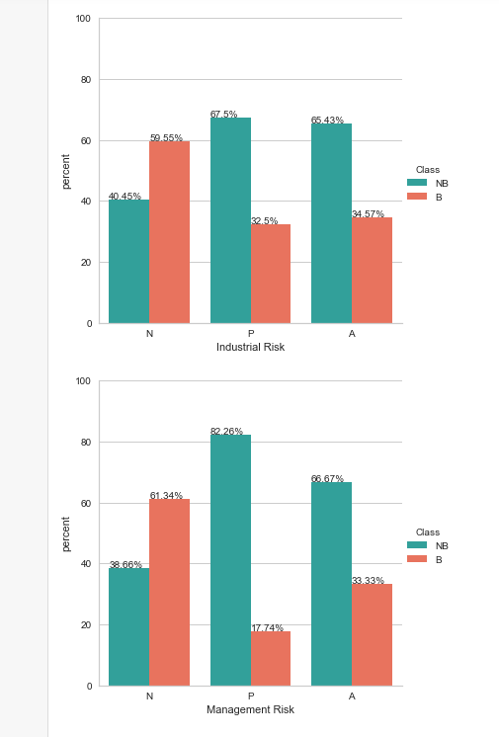
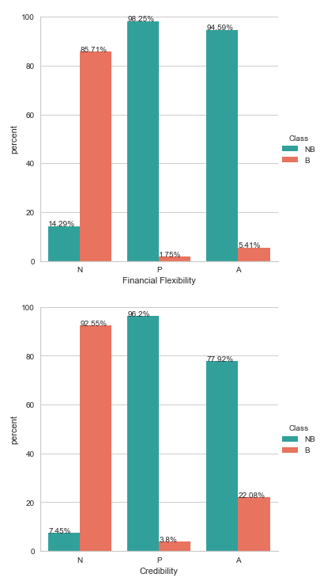
Bankruptcy Analysis
Exploratory Data Analysis(EDA)

Slide 35
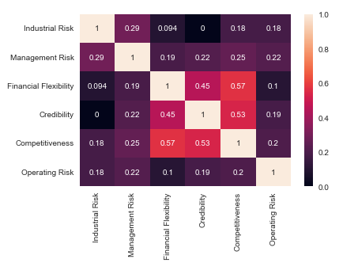
Bankruptcy Analysis
Exploratory Data Analysis(EDA)
Correlation heatmap关联分析

Slide 36
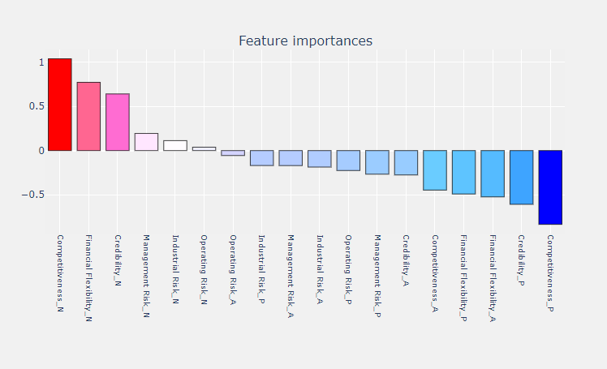
Bankruptcy Analysis
Regression回归分析

Slide 37
Bankruptcy Analysis
Bankruptcy Risk 破产风险
Industry risk (IR) 行业风险
Credibility (CR)可信度（信用）
Quantify/量化
One to Many/一对多关系
Ranking/排序
Explain/解释
Control/控制
Predict/预测
Management risk(MR)管理风险
Competitiveness (CO)竞争性
Financial Flexibility(FF)金融灵活性
Operating Risk (OP)操作风险
Regression Model 回归分析模型

Slide 38
RISK ANALYSIS
面试怎么讲
有相关经验
没有相关经验
常见面试问题：
Tell me one time you use data to generate insights?
Identify Business problems
Identify data analysis solutions
visualize the insights
Present analysis and recommendations
Here is one example I have done(have experience)/here is my approach(no experience)
How do you find business opportunities/problems
identify business goals, e.g. marketing needs to retain customers…
How do you do data analysis?
Data life cycle at high level
How do you prepare data?
Data Architecture

Slide 39
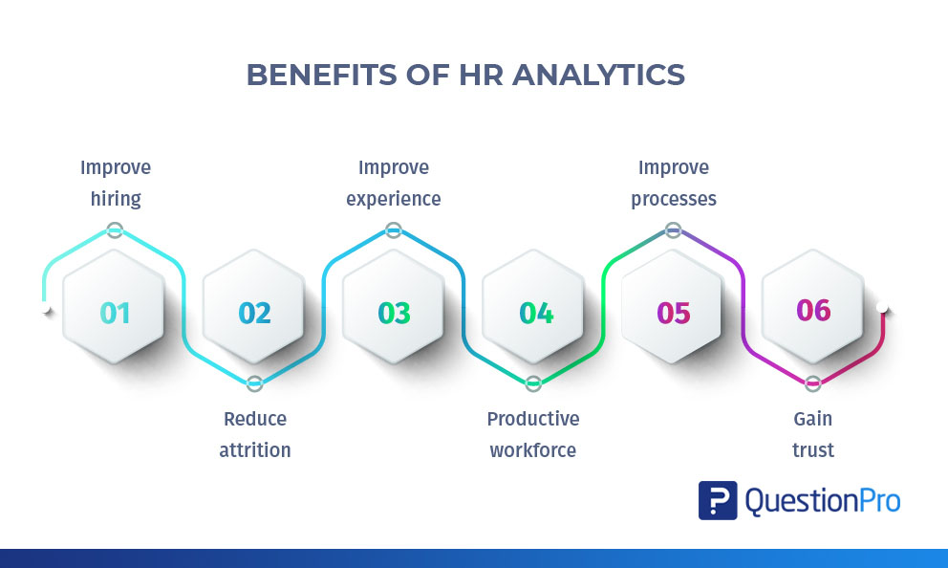
Business Data analysis /商业数据分析
HR/人事部门数据分析

Slide 40
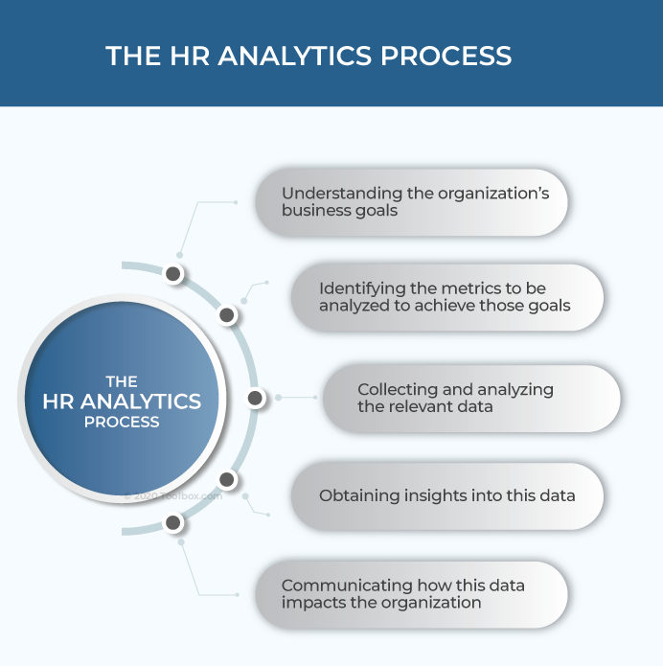
Business Data analysis /商业数据分析
HR/人事部门数据分析

Slide 41
Business Data analysis /商业数据分析
HR/人事部门数据
Age | Attrition | BusinessTravel | DailyRate | Department | DistanceFromHome | Education | EducationField | EmployeeCount | EmployeeNumber | EnvironmentSatisfaction
41 | Yes | Travel_Rarely | 1102 | Sales | 1 | 2 | Life Sciences | 1 | 1 | 2
49 | No | Travel_Frequently | 279 | Research & Development | 8 | 1 | Life Sciences | 1 | 2 | 3
37 | Yes | Travel_Rarely | 1373 | Research & Development | 2 | 2 | Other | 1 | 4 | 4
33 | No | Travel_Frequently | 1392 | Research & Development | 3 | 4 | Life Sciences | 1 | 5 | 4

Slide 42
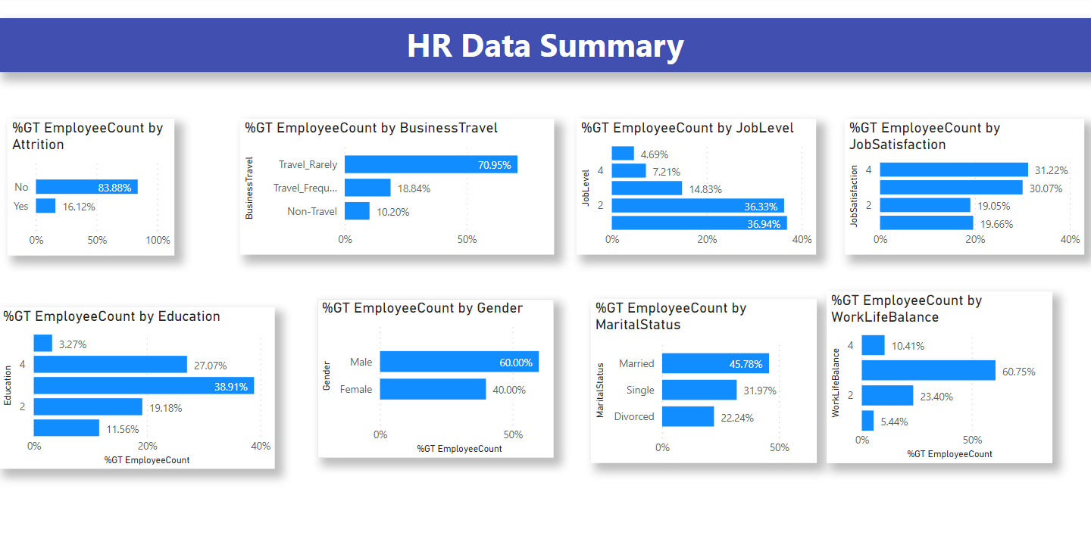
Business Data analysis /商业数据分析
Summarize the data

Slide 43
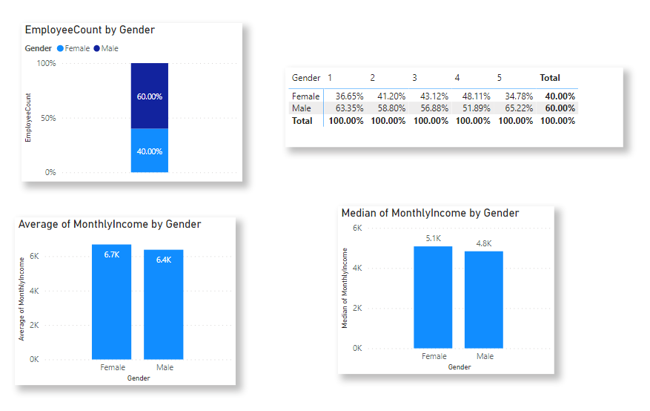
Business Data analysis /商业数据分析
HR/人事部门数据分析
Improve Experience --- diversity analysis

Slide 44
Business Data analysis /商业数据分析
HR/人事部门数据分析
Compensation and Benefits Strategy
year | year 1 | year 2 | year 3 | year 4 | year 5
RRSP match | 3% | 4% | 5% | 5% | 5%

Slide 45
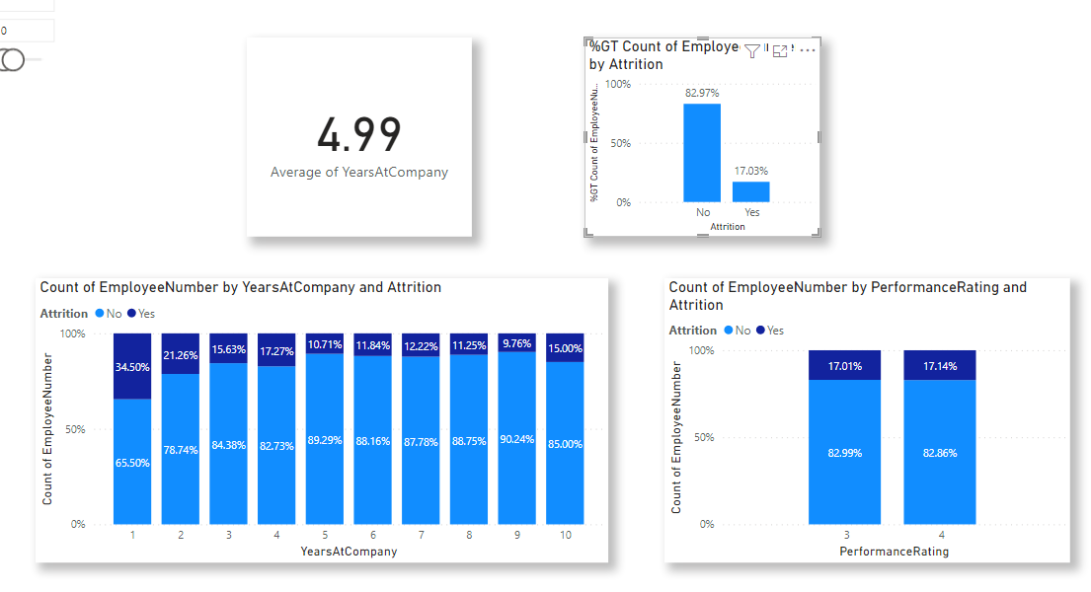
Business Data analysis /商业数据分析
HR/人事部门数据分析
Compensation and Benefits Strategy

Slide 46
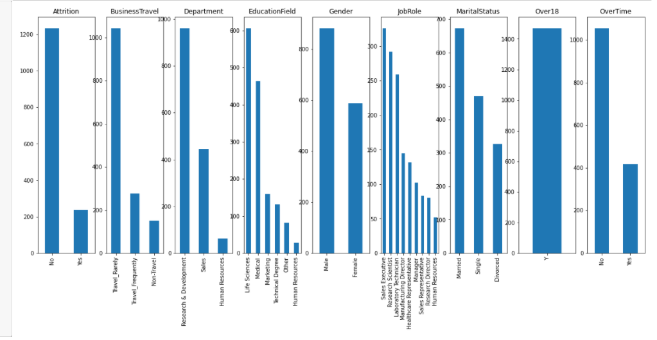
Business Data analysis /商业数据分析
Attrition analysis员工流失分析
Exploratory Data Analysis (EDA)

Slide 47
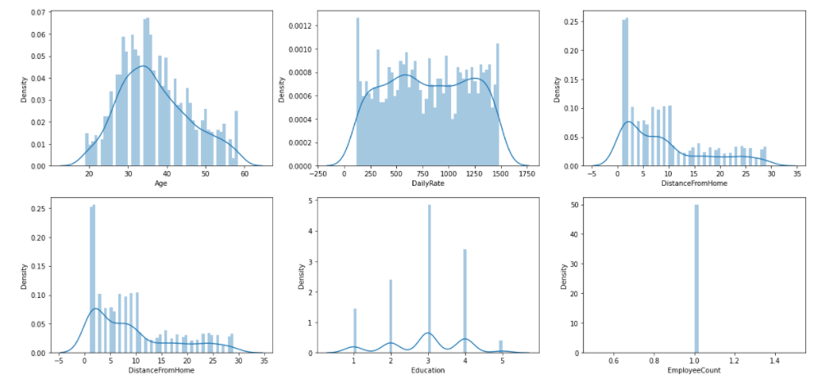
Business Data analysis /商业数据分析
Attrition analysis员工流失分析
Exploratory Data Analysis (EDA)

Slide 48
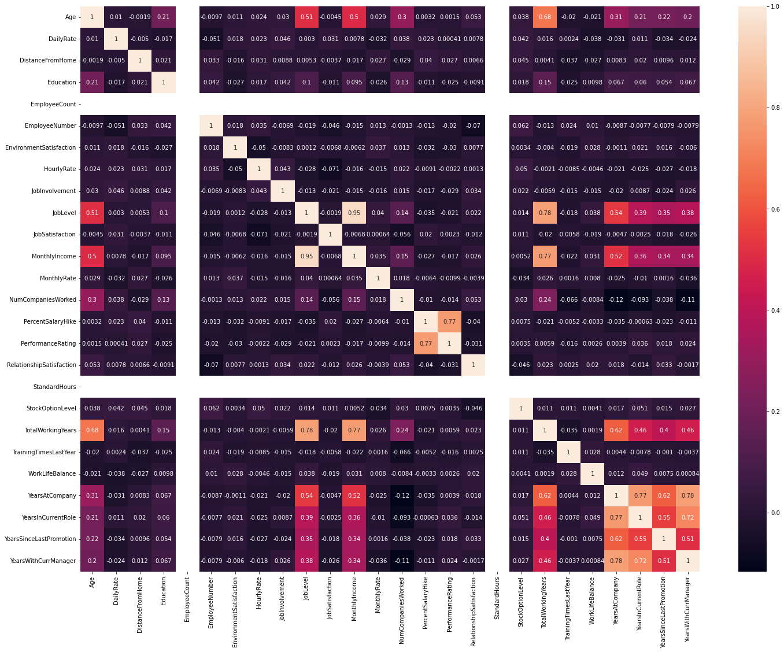
Business Data analysis /商业数据分析

Slide 49
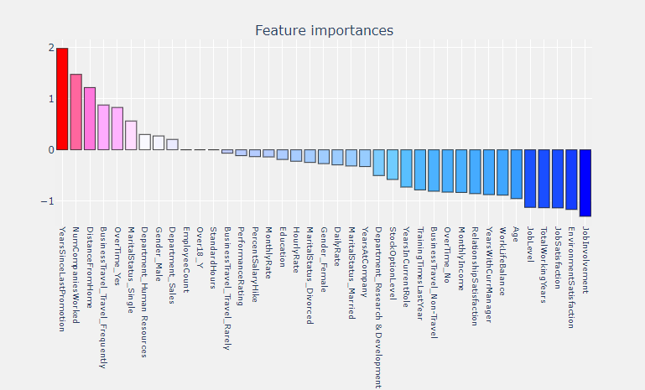
Business Data analysis /商业数据分析
Attrition analysis员工流失分析
Exploratory Data Analysis (EDA)

Slide 50

Credit Risk & Credit Losses
Business Data analysis /商业数据分析

Slide 51
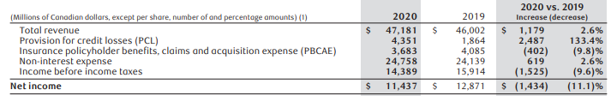
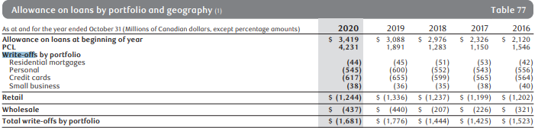
Credit Risk & Credit Losses
Business Data analysis /商业数据分析

Slide 52
Credit Risk & Credit Losses
Business Data analysis /商业数据分析
Credit risk refers to the potential for loss due to the failure of a borrower to make a payment when it is due
信贷风险是指客户还不起钱的风险
Credit losses: losses from delinquent and bad debt or other credit. 风险发生后，信贷风险变成信贷损失
Can we implement data-driven strategy to 1, Prevent Credit Losses?怎么防止信用借贷损失？ 2, Mitigate Credit Risk (and better PCL estimation)? 减轻信用借贷风险 3, Improve Portfolio Performance?怎么提高借贷组合业绩

Slide 53
Credit analysis 信用借贷分析
Business Data analysis /商业数据分析
Data数据
Customer ID | Annual Income | Maximum Open Credit | Current Credit Balance | Monthly Debt | Current Loan Amount | Number of Open Accounts | Credit Score | Term | Home Ownership
ded0b3c3-6bf4-4091-8726-47039f2c1b90 | 2074116 | 1058970 | 621908 | 42000.83 | 611314 | 9 | 747 | Short Term | Home Mortgage
1630e6e3-34e3-461a-8fda-09297d3140c8 | 1919190 | 904442 | 679573 | 36624.4 | 266662 | 11 | 734 | Short Term | Home Mortgage
2c60938b-ad2b-4702-804d-eeca43949c52 | 871112 | 388036 | 38532 | 8391.73 | 153494 | 10 | 709 | Short Term | Rent
12116614-2f3c-4d16-ad34-d92883718806 | 780083 | 531322 | 156940 | 16771.87 | 176242 | 16 | 727 | Short Term | Rent
39888105-fd5f-4023-860a-30a3e6f5ccb7 | 1761148 | 468072 | 359765 | 39478.77 | 321992 | 14 | 744 | Short Term | Home Mortgage
6878d414-6a22-4712-ae43-9b3f798e463a | 760380 | 476872 | 258647 | 6526.69 | 202928 | 6 | 741 | Short Term | Rent
48113a98-a4a0-4956-b57d-f0ce344826fb | 1783606 | 1449162 | 281599 | 36563.98 | 621786 | 42 | 733 | Long Term | Home Mortgage

Slide 54
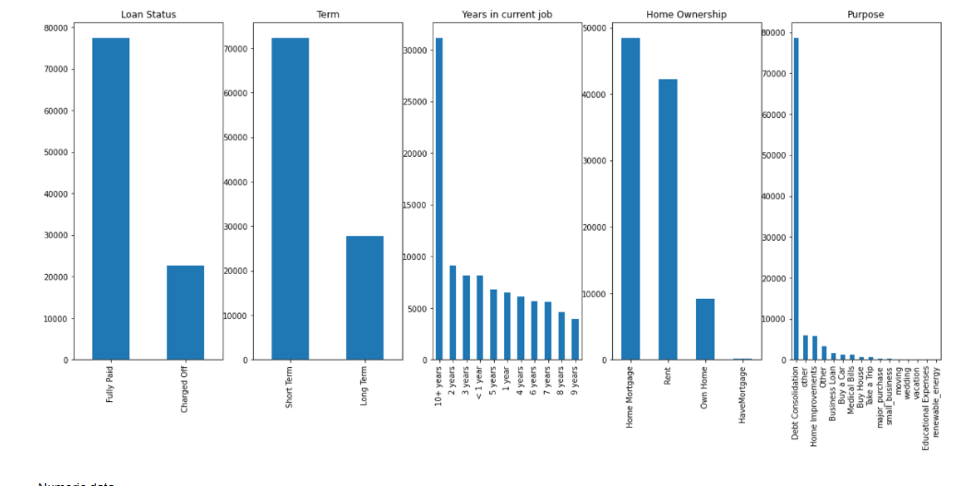
Credit analysis 信用借贷分析
Business Data analysis /商业数据分析
Exploratory data analysis

Slide 55
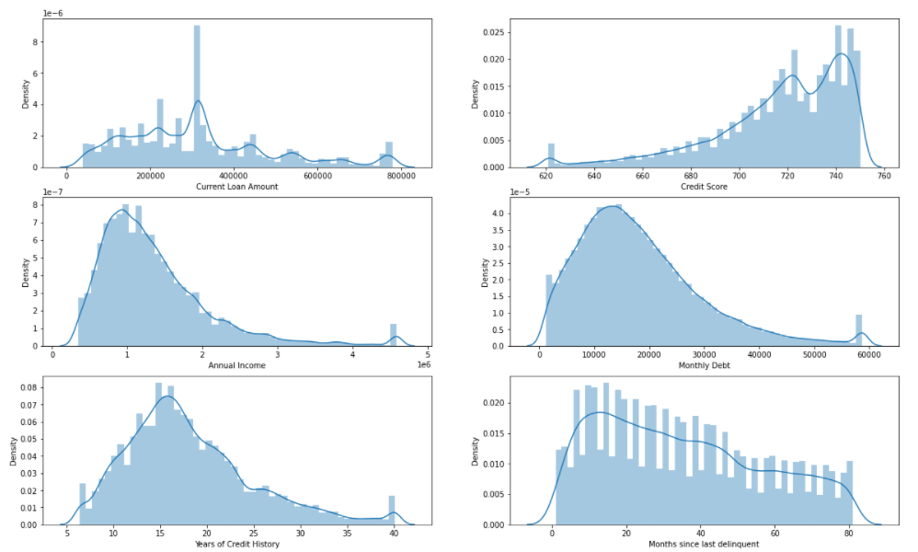
Business Data analysis /商业数据分析
Exploratory data analysis

Slide 56
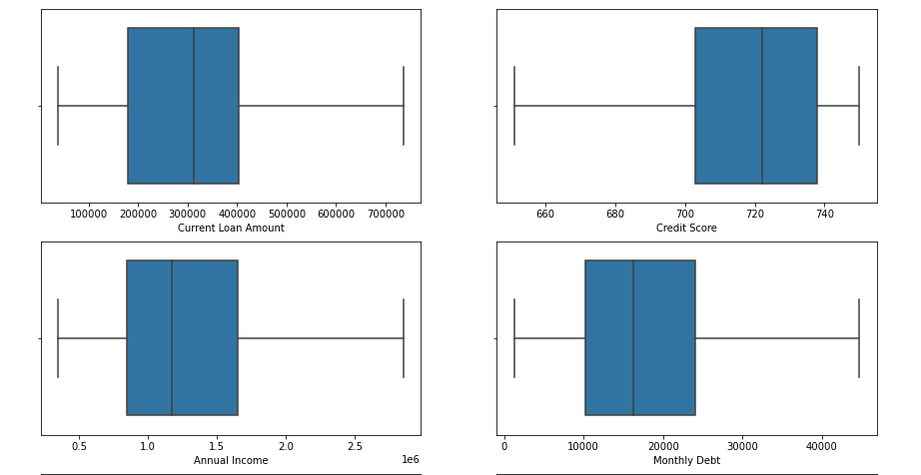
Business Data analysis /商业数据分析
Exploratory data analysis

Slide 57
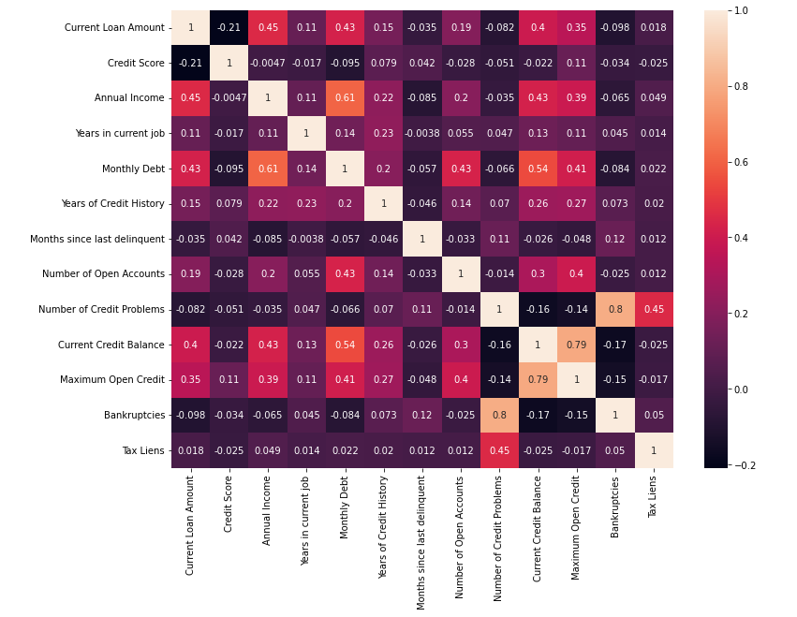
Business Data analysis /商业数据分析
correlation analysis

Slide 58
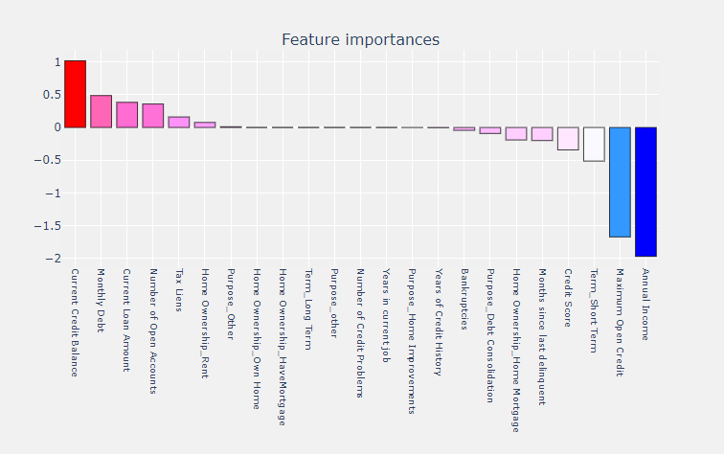
Business Data analysis /商业数据分析
Regression analysis

Slide 59
Business Data analysis /商业数据分析
Regression analysis
Credit Loss
Current balance
Monthly debt
Quantify/量化
One to Many/一对多关系
Ranking/排序
Explain/解释
Control/控制
Predict/预测
Current loan amount
Annual income
Number of open acct.
Maximum open credit
Regression Model 回归分析模型

Slide 60
Business Data analysis /商业数据分析
Data Product 数据产品---
Productization of your Insights/Recommendations
产品化你的见解
Explain解释
Control 控制
Predict 预测

Slide 61
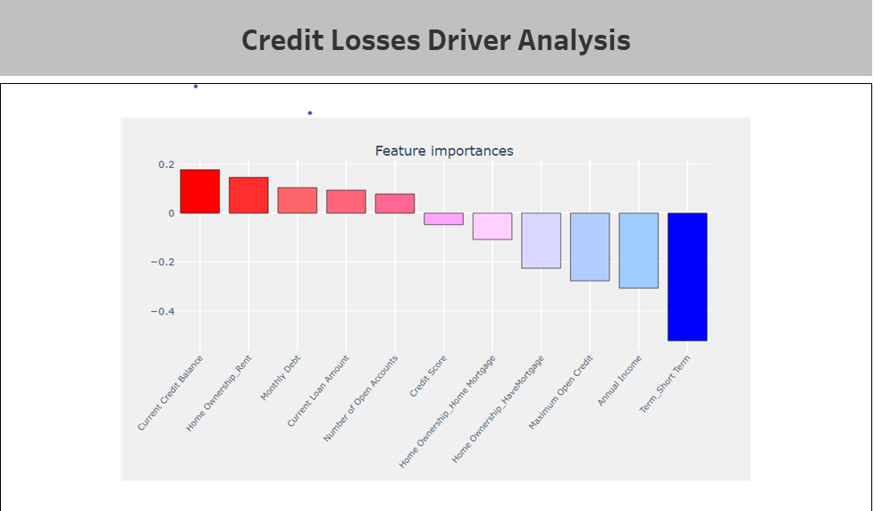
Business Data analysis /商业数据分析
Explain

Slide 62
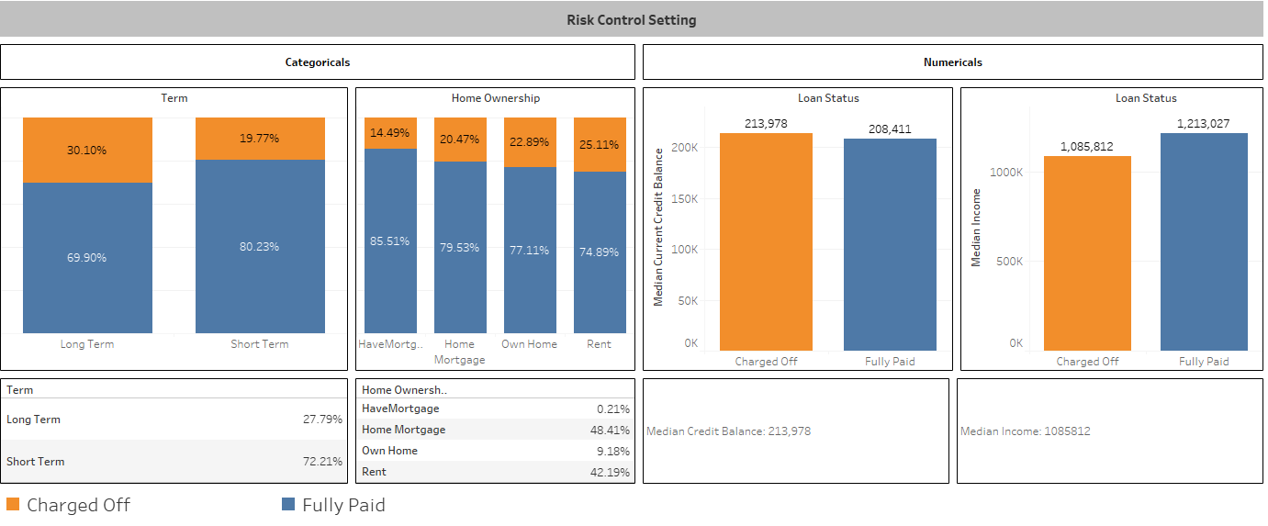
Business Data analysis /商业数据分析
Control

Slide 63
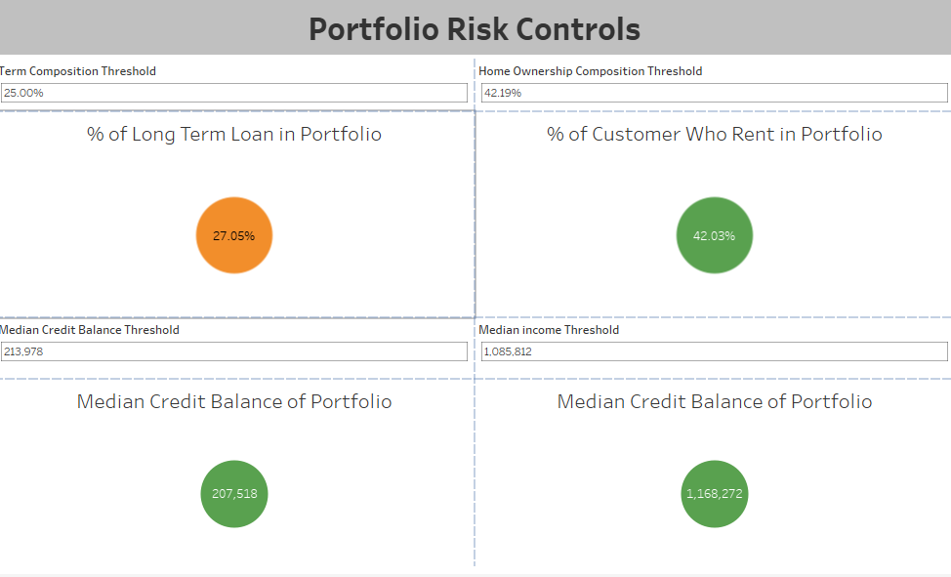
Business Data analysis /商业数据分析
Control

Slide 64
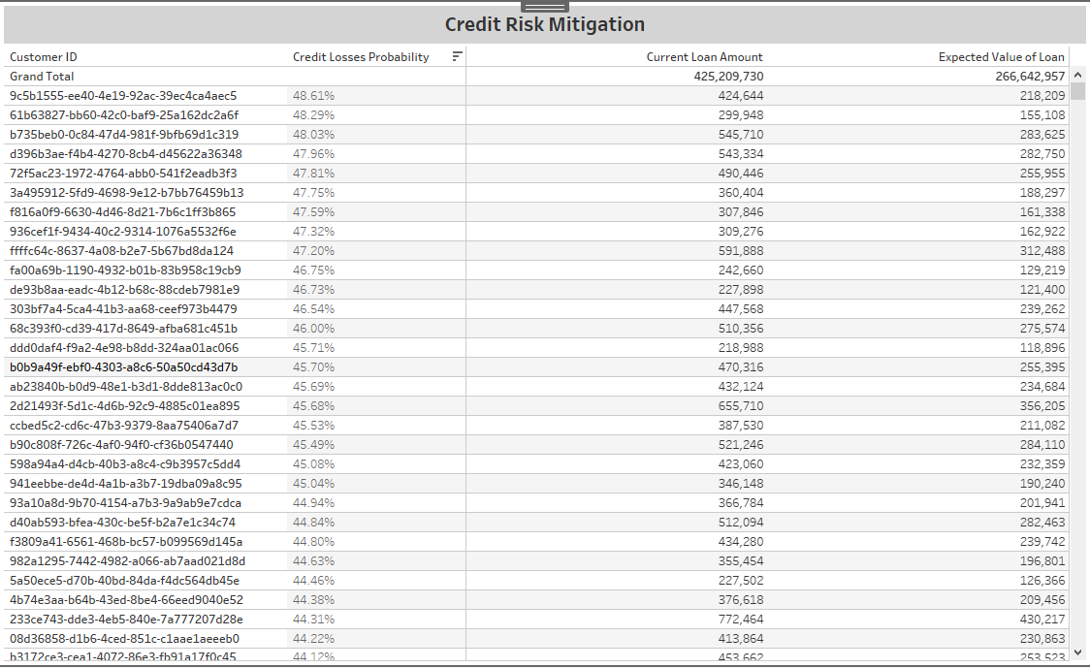
Business Data analysis /商业数据分析
Predict

Slide 65


Business Data analysis /商业数据分析
饿了business problems
business requirements

Slide 66



Business Data analysis /商业数据分析
Data Collection
Data Preparation
Data Preparation

Slide 67

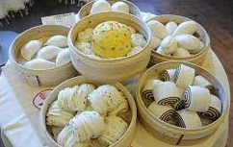

Business Data analysis /商业数据分析
Productization
Data Analysis
Data Products

Slide 68

Business Data analysis /商业数据分析
解决问题
business problems solved
Data Products

Slide 69
CHURN ANALYSIS
面试怎么讲
有相关经验
没有相关经验
常见面试问题：
Tell me one time you use data to generate insights?
Identify Business problems
Identify data analysis solutions
visualize the insights
Present analysis and recommendations
Here is one example I have done(have experience)/here is my approach(no experience)
How do you find business opportunities/problems
identify business goals, e.g. marketing needs to retain customers…
How do you do data analysis?
Data life cycle at high level
How do you prepare data?
Data Architecture

Slide 70
Business Data analysis/商业数据分析
Sales/销售部门项目
三个项目帮助同学轻松通过银行销售部门面试。
第一个项目：帮助销售部门提高销售业绩：如何用数据分析来解决这个问题。
第二个项目： 银行销售部门挽留老客户-如何数据分析解决这个问题。
第三个项目：促销活动-少花钱多办事-如何用数据分析解决这个问题。
银行内部部门分门别类，同学们写简历，面试要有针对性，通过项目理解银行想招什么样的人，少走弯路，直接命中目标！

Slide 71
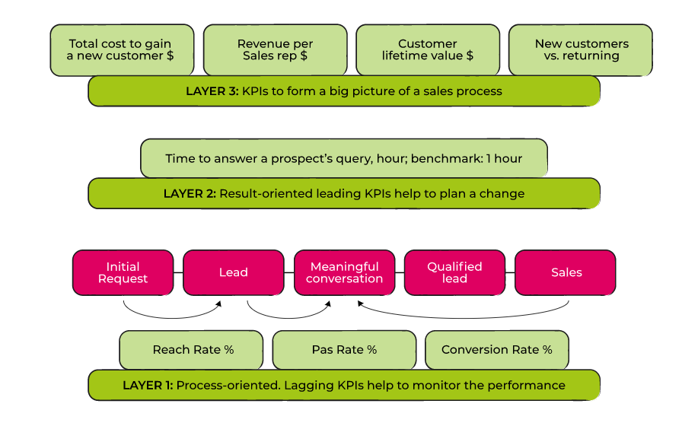
Business problems 1:Sales performance kpi 银行销售业务问题1：怎么提高销售业绩

Slide 72
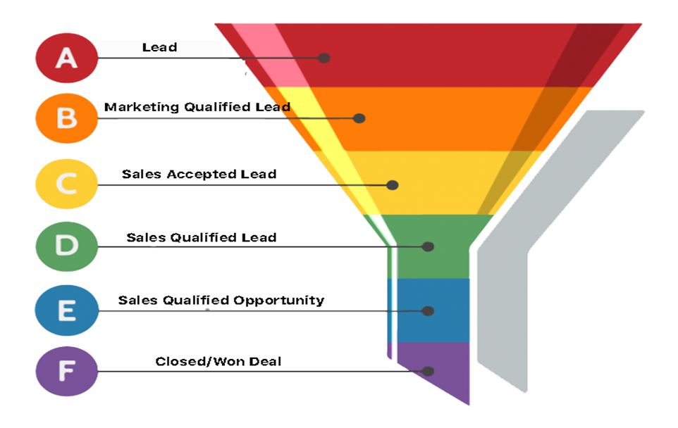
Sales conversion rate 销售人员客户转换率

Slide 73
Sales data/销售数据
user_type | registration_status | onboarded_month | user_login_month | count_user_login | auth_month | transaction_amount | deposit_count | transfer_count | deposit_amount | transfer_amount
Primary | pendingActivation | 2/1/2020
Primary | activated | 2/1/2020
Primary | onboarded | 3/1/2020 | 4/1/2020 | 3
Primary | onboarded | 3/1/2020 | 5/1/2020 | 2
Primary | onboarded | 3/1/2020 | 7/1/2020 | 1
Primary | onboarded | 3/1/2020 | 10/1/2020 | 1
Primary | onboarded | 3/1/2020 | 3/1/2021 | 3
Primary | onboarded | 3/1/2020 | 5/1/2021 | 1
Primary | onboarded | 3/1/2020 | 3/1/2020 | 2
Primary | onboarded | 3/1/2020 | 4/1/2020 | 1
Primary | onboarded | 3/1/2020 | 5/1/2020 | 1
Primary | onboarded | 3/1/2020 | 4/1/2021 | 1
Primary | onboarded | 3/1/2020 | 7/1/2021 | 1
Primary | onboarded | 3/1/2020
Primary | onboarded | 3/1/2020 | 3/1/2020 | 1
Primary | onboarded | 3/1/2020 | 4/1/2020 | 9 | 4/1/2020 | 40 | 1 | 2 | 50 | -10
Primary | onboarded | 3/1/2020 | 5/1/2020 | 2 | 5/1/2020 | -12.5 | 0 | 2 |  | -12.5
Primary | onboarded | 3/1/2020 | 6/1/2020 | 4 | 6/1/2020 | -22.5 | 0 | 3 |  | -22.5
Primary | onboarded | 3/1/2020 | 7/1/2020 | 3 | 7/1/2020 | 72.5 | 1 | 2 | 100 | -27.5
Primary | onboarded | 3/1/2020 | 8/1/2020 | 1 | 8/1/2020 | -7.5 | 0 | 1 |  | -7.5

Slide 74
Sales data/销售数据
Primary Data | Description
member_id | Unique ID per User
primary_act_holder_member_id | Unique ID for the primary account holder (Primary)
user_type | Whether it is a Primary or Secondary
registration_status | Indicates the current Registration Status
onboarded_month | When then account was onboarded, if applicable
user_login_month | Month of logins, if applicable
count_user_login | Number of logins in month
auth_month | Month of authorizations, if applicable
transaction_amt | Total transaction amounts
deposit_count | Total count of deposits in authorization month
transfer_count | Total count of transfers in authorization month
deposit_amt | Total sum of deposits in authorization month
transfer_amt | Total sum of transfers in authorization month
Secondary Data | Description
member_id | Unique ID per User
primary_act_holder_member_id | Unique ID for the primary account holder (Primary)
user_type | Whether it is a Primary or Secondary
registration_status | Indicates the current Registration Status
onboarded_month | When then account was onboarded, if applicable
user_login_month | Month of logins, if applicable
count_user_login | Number of logins in month
auth_month | Month of authorizations, if applicable
transaction_amt | Total transaction amounts
purchase_count | Total count of purchases in authorization month
receive_count | Total count of received allowances in authorization month
purchase_amt | Total sum of purchases in authorization month
receive_amt | Total sum of received allowances in authorization month

Slide 75
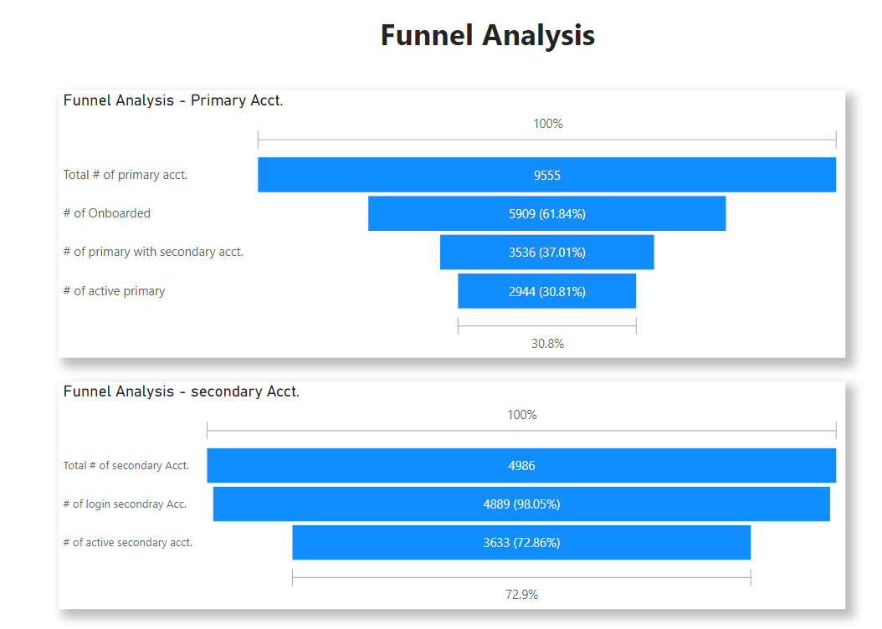
Funnel analysis 过滤分析
Analysis/分析: Primary onboard rate is around 62% and Primary with secondary accounts rate is around 37% and 31% of Primary actively using the product. Once secondary open accounts, their conversion rate is much higher.
Recommendations/推荐: Compare the 31% conversion rate with benchmark and direct marketing efforts accordingly.

Slide 76
Business problems 2: customer relationship 业务问题2：客户关系
The true success of sales is in building a customer relationship that spans for as long as possible. 销售业绩与客户关系的成功与否密切相关
That makes customer retention a high-priority goal. 留住客户是优先目标
Why should sales focus on customer retention as a metric for measuring sales success? 销售应该把留在客户作为一个标的来评测销售的成功与否
new customer acquisition is five times more costly when compared to the cost of retaining existing customers 获得新客户成本5倍高于留住一个老客户

Slide 77
Cohort analysis
A cohort is a group of users who share a common characteristic over a certain period of time. Cohort analysis is the study of the common characteristics of these users over a specific period.
一组有相同特征的在一段时间内的客户。Cohort是学习这些客户的特征
cohort analysis is commonly used to identify reasons why customers leave and what can be done to prevent them from leaving
Cohort 通常是用于找到客户为什么离开的原因
Acquisition Cohorts: This cohort divides users based on when they were acquired or signed up for a product. Depending on your product, user acquisition could be tracked daily, weekly, or monthly.
一种cohort 分析是按照开户时间来分析他们的行为

Slide 78
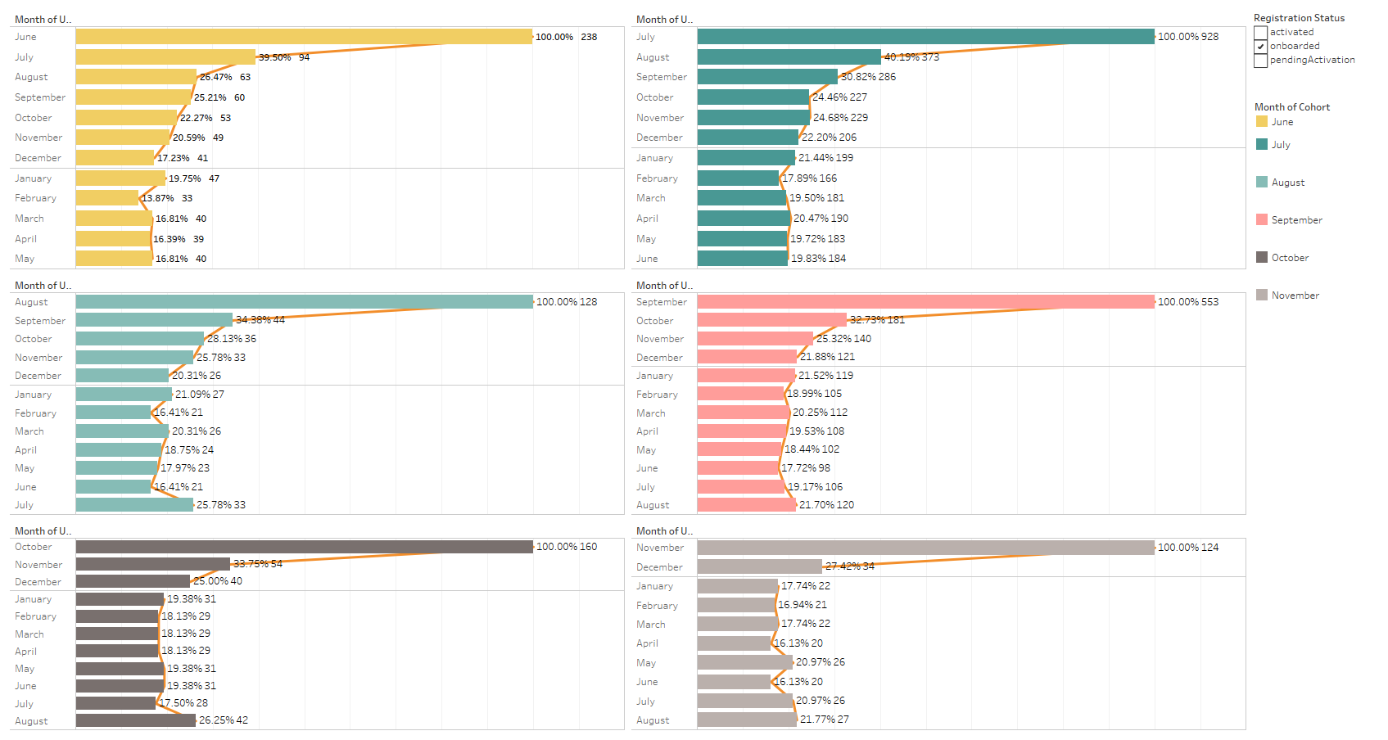
Cohort analysis
Assumptions: The Retention Rates were calculated based on “User Login Month”.
Analysis: The Retention Rates (Onboard June – Nov.) for primary accounts range from 16.8% to 26.3% . The rates tend to stabilize after 2-3 months.
Recommendations: time the marketing efforts based on the time window.

Slide 79
Business problems 3 :Marketing campaigns 业务问题3：怎么提高促销有效率
Marketing campaigns promote products through different types of media, such as television, radio, print, and online platforms.
促销活动通过不同的平台，比如电视，广播，网络，手机等平台
How to improve Marketing campaigns efficiency? Less investment more customers ?
怎么提高促销活动的效率，少花钱多办事？

Slide 80
RFM Analysis
RFM analysis is a powerful tool in marketing that helps marketers make the best of their advertising budget.
RFM 分析是一个分析有力的工具来帮助营销来优化广告预算
Recency, Frequency, Monetary Value (RFM)
RFM 是指新近度，频率，消费价值

Slide 81
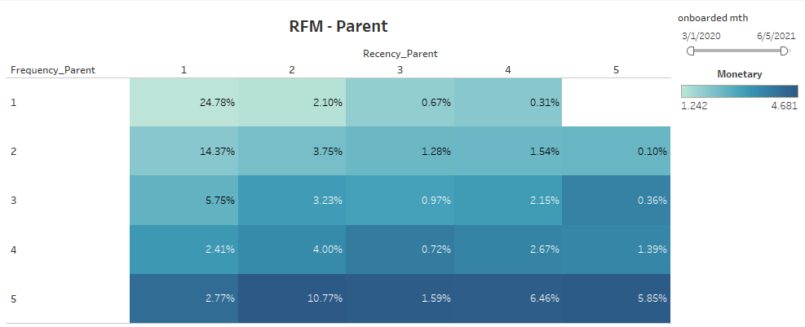
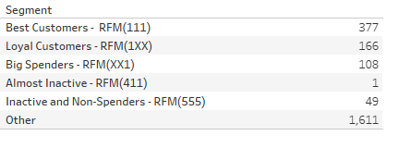
RFM
Analysis: From the RFM of heatmap (upper figure)we can see there are some segments with high R and high F with low M. Also in high R and low F and high M. Lower figure shows the segments based on the RFM.
Recommendations: direct the marketing efforts based on the segments. For examples aggressive incentives to Inactive customers.

Slide 82


Business Data analysis /商业数据分析
MARKETING/市场营销部门项目
Following the money is always a good way to identify business opportunities/跟着钱走总能发现商业机会

Slide 83
Business Data analysis/商业数据分析
MARKETING/市场营销部门项目
Type of Marketing Campaigns/市场营销活动的主要种类
Product Marketing Campaign/产品营销活动
Acquisition Marketing Campaign/客户获得
Customer retention Campaign/客户挽留
Budget/预算: Not all marketing campaigns require an incremental budget, but many still do. Factor in the agency, advertising, and freelance costs, if appropriate, and factor these numbers into any ROI analysis/投资回报分析 for your campaign.

Slide 84
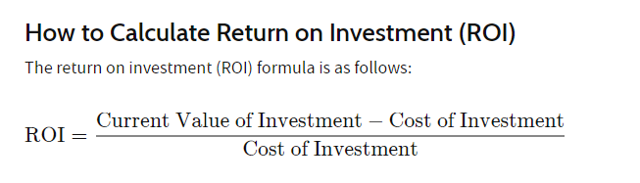
Business Data analysis /商业数据分析
MARKETING/市场营销部门项目
怎么算促销活动的回报？

Slide 85
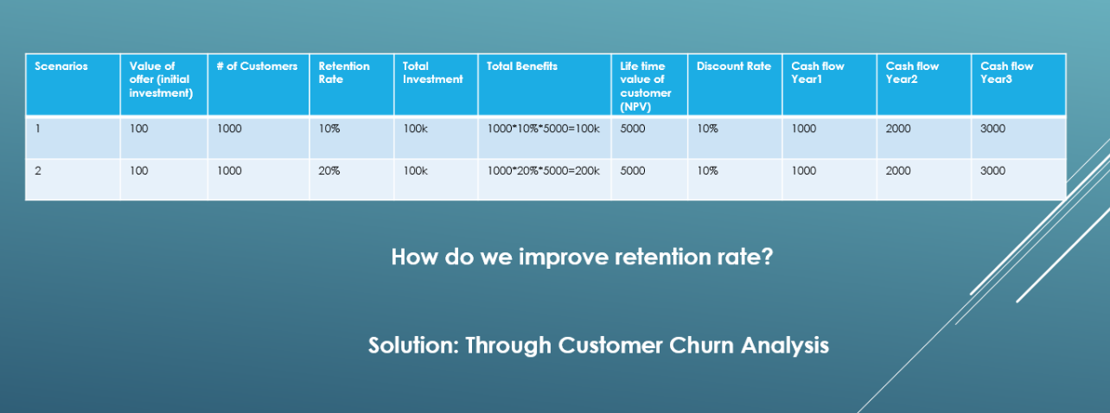
Business Data analysis /商业数据分析
ROI Financial analysis
随机
非随机

Slide 86
Business Data analysis /商业数据分析
Churn analysis/客户流失分析
Churn analysis is a review of a bank’s customers data that reveals their composition and trends. It looks for correlations between customers who became inactive during a period of time and variables such as tenure, product holding, service calls, seasonality, and demographics.
客户流失分析是分析银行客户组成和趋势的数据。寻找客户的特征比如时间长度，持有什么产品，打过服务电话，季节性，人口成分等与客户流失的关联。

Slide 87
Business Data analysis /商业数据分析
Churn analysis/客户流失分析---data 数据
CustomerId | CreditScore | Geography | Gender | Age | Tenure | Balance | NumOfProducts | HasCrCard | IsActiveMember | EstimatedSalary | Churn
15592531 | 822 | France | Male | 50 | 7 | 0 | 2 | 1 | 1 | 10062.8 | yes
15577657 | 732 | France | Male | 41 | 8 | 0 | 2 | 1 | 1 | 170886.17 | Yes
15614049 | 664 | France | Male | 55 | 8 | 0 | 2 | 1 | 1 | 139161.64 | yes
15640635 | 769 | France | Male | 29 | 8 | 0 | 2 | 1 | 1 | 172290.61 | yes
15724944 | 663 | France | Male | 34 | 7 | 0 | 2 | 1 | 1 | 180427.24 | yes
15625524 | 512 | France | Male | 40 | 5 | 0 | 2 | 1 | 1 | 146457.83 | No
15789669 | 510 | France | Male | 65 | 2 | 0 | 2 | 1 | 1 | 48071.61 | No
15810845 | 636 | France | Male | 42 | 2 | 0 | 2 | 1 | 1 | 55470.78 | No
15656176 | 501 | France | Male | 57 | 10 | 0 | 2 | 1 | 1 | 47847.19 | No
15624592 | 603 | France | Male | 31 | 8 | 0 | 2 | 1 | 1 | 169915.02 | No
15727829 | 567 | France | Male | 42 | 2 | 0 | 2 | 1 | 1 | 167984.61 | No
15636684 | 727 | France | Male | 34 | 10 | 0 | 2 | 1 | 1 | 198637.34 | yes
15653857 | 498 | France | Male | 34 | 2 | 0 | 2 | 1 | 1 | 148528.24 | yes
15668893 | 782 | France | Male | 39 | 8 | 0 | 2 | 1 | 1 | 33949.67 | yes
15785819 | 681 | France | Male | 38 | 3 | 0 | 2 | 1 | 1 | 112491.96 | yes
15811490 | 627 | France | Male | 33 | 5 | 0 | 2 | 1 | 1 | 103737.82 | yes
15576256 | 582 | France | Male | 39 | 5 | 0 | 2 | 1 | 1 | 129892.93 | yes
15676715 | 640 | France | Male | 68 | 9 | 0 | 2 | 1 | 1 | 199493.38 | yes
15642291 | 685 | France | Male | 23 | 8 | 0 | 2 | 1 | 1 | 112239.03 | yes

Slide 88
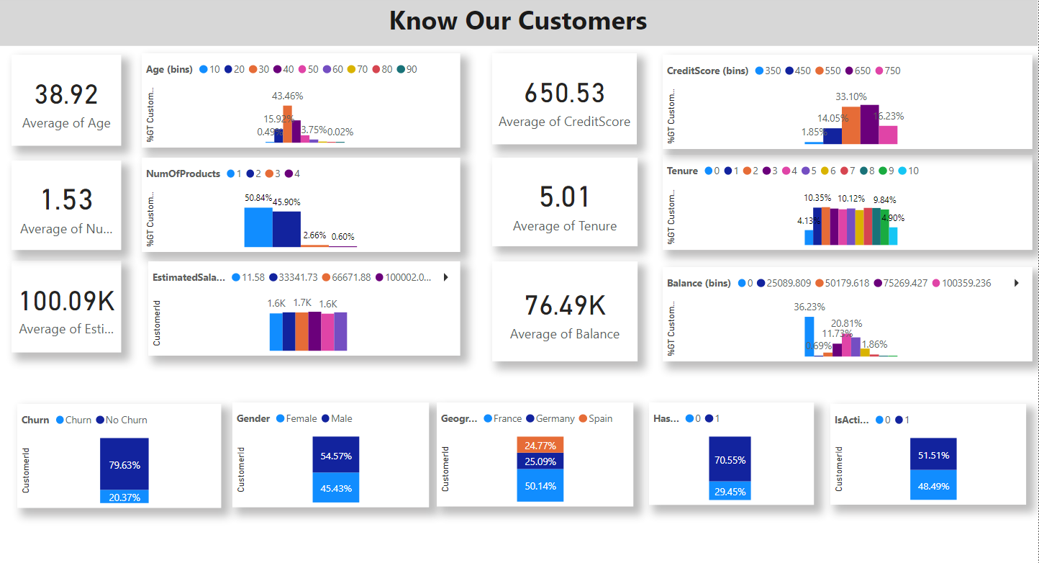
Summarize your data/总结你的数据
The power of visualization/视觉化的威力

Slide 89
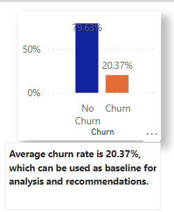

CHURN ANALYSIS
Baseline/基线

Slide 90

CHURN ANALYSIS
三板斧：切，统计总和，比较

Slide 91

CHURN ANALYSIS
Baseline/基线

Slide 92

CHURN ANALYSIS
Baseline/基线

Slide 93

CHURN ANALYSIS
Baseline/基线

Slide 94

CHURN ANALYSIS

Slide 95

CHURN ANALYSIS--- correlation /关联

Slide 96
CHURN ANALYSIS
Quantify/量化
One to Many/一对多关系
Ranking/排序

Slide 97

CHURN ANALYSIS
REGRESSION/回归

Slide 98

CHURN ANALYSIS
REGRESSION/回归

Slide 99

CHURN ANALYSIS---REGRESSION/回归

Slide 100
CHURN ANALYSIS---REGRESSION/回归
Churn/流失
CreditScore
Age
Quantify/量化
One to Many/一对多关系
Ranking/排序
Explain/解释
Control/控制
Predict/预测
Geography
Tenure
Gender
Balance
Regression Model 回归分析模型

Slide 101
CHURN ANALYSIS
面试怎么讲
有相关经验
没有相关经验
常见面试问题：
Tell me one time you use data to generate insights?
Identify Business problems
Identify data analysis solutions
visualize the insights
Present analysis and recommendations
Here is one example I have done(have experience)/here is my approach(no experience)
How do you find business opportunities/problems
identify business goals, e.g. marketing needs to retain customers…
How do you do data analysis?
Data life cycle at high level
How do you prepare data?
Data Architecture

Slide 102
Credit Risk & Credit Losses
Business Data analysis /商业数据分析

Slide 103
Credit Risk & Credit Losses
Business Data analysis /商业数据分析

Slide 104
Credit Risk & Credit Losses
Business Data analysis /商业数据分析
Credit risk refers to the potential for loss due to the failure of a borrower to make a payment when it is due
信贷风险是指客户还不起钱的风险
Credit losses: losses from delinquent and bad debt or other credit. 风险发生后，信贷风险变成信贷损失
Can we implement data-driven strategy to 1, Prevent Credit Losses?怎么防止信用借贷损失？ 2, Mitigate Credit Risk (and better PCL estimation)? 减轻信用借贷风险 3, Improve Portfolio Performance?怎么提高借贷组合业绩

Slide 105
Credit analysis 信用借贷分析
Business Data analysis /商业数据分析
Data数据
Customer ID | Annual Income | Maximum Open Credit | Current Credit Balance | Monthly Debt | Current Loan Amount | Number of Open Accounts | Credit Score | Term | Home Ownership
ded0b3c3-6bf4-4091-8726-47039f2c1b90 | 2074116 | 1058970 | 621908 | 42000.83 | 611314 | 9 | 747 | Short Term | Home Mortgage
1630e6e3-34e3-461a-8fda-09297d3140c8 | 1919190 | 904442 | 679573 | 36624.4 | 266662 | 11 | 734 | Short Term | Home Mortgage
2c60938b-ad2b-4702-804d-eeca43949c52 | 871112 | 388036 | 38532 | 8391.73 | 153494 | 10 | 709 | Short Term | Rent
12116614-2f3c-4d16-ad34-d92883718806 | 780083 | 531322 | 156940 | 16771.87 | 176242 | 16 | 727 | Short Term | Rent
39888105-fd5f-4023-860a-30a3e6f5ccb7 | 1761148 | 468072 | 359765 | 39478.77 | 321992 | 14 | 744 | Short Term | Home Mortgage
6878d414-6a22-4712-ae43-9b3f798e463a | 760380 | 476872 | 258647 | 6526.69 | 202928 | 6 | 741 | Short Term | Rent
48113a98-a4a0-4956-b57d-f0ce344826fb | 1783606 | 1449162 | 281599 | 36563.98 | 621786 | 42 | 733 | Long Term | Home Mortgage

Slide 106
Credit analysis 信用借贷分析
Business Data analysis /商业数据分析
Exploratory data analysis

Slide 107
Business Data analysis /商业数据分析
Exploratory data analysis

Slide 108
Business Data analysis /商业数据分析
Exploratory data analysis

Slide 109
Business Data analysis /商业数据分析
correlation analysis

Slide 110
Business Data analysis /商业数据分析
Regression analysis

Slide 111
Business Data analysis /商业数据分析
Regression analysis
Credit Loss
Current balance
Monthly debt
Quantify/量化
One to Many/一对多关系
Ranking/排序
Explain/解释
Control/控制
Predict/预测
Current loan amount
Annual income
Number of open acct.
Maximum open credit
Regression Model 回归分析模型

Slide 112
Business Data analysis /商业数据分析
Data Product 数据产品---
Productization of your Insights/Recommendations
产品化你的见解
Explain解释
Control 控制
Predict 预测

Slide 113
Business Data analysis /商业数据分析
Explain

Slide 114
Business Data analysis /商业数据分析
Control

Slide 115
Business Data analysis /商业数据分析
Control

Slide 116
Business Data analysis /商业数据分析
Predict

Slide 117
Business Data analysis /商业数据分析
饿了business problems
business requirements

Slide 118
Business Data analysis /商业数据分析
Data Collection
Data Preparation
Data Preparation

Slide 119
Business Data analysis /商业数据分析
Productization
Data Analysis
Data Products

Slide 120
Business Data analysis /商业数据分析
解决问题
business problems solved
Data Products

Slide 121
CHURN ANALYSIS
面试怎么讲
有相关经验
没有相关经验
常见面试问题：
Tell me one time you use data to generate insights?
Identify Business problems
Identify data analysis solutions
visualize the insights
Present analysis and recommendations
Here is one example I have done(have experience)/here is my approach(no experience)
How do you find business opportunities/problems
identify business goals, e.g. marketing needs to retain customers…
How do you do data analysis?
Data life cycle at high level
How do you prepare data?
Data Architecture

